Slide 1

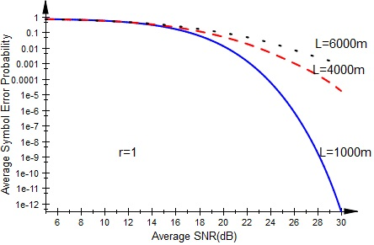
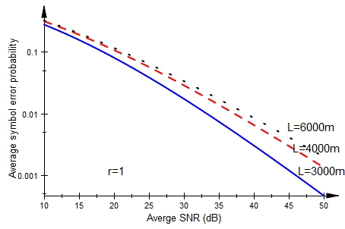
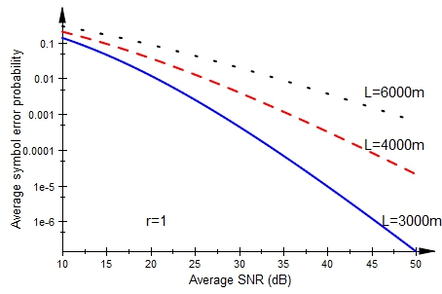
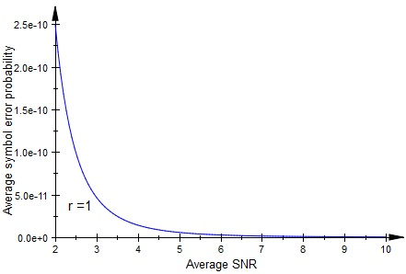
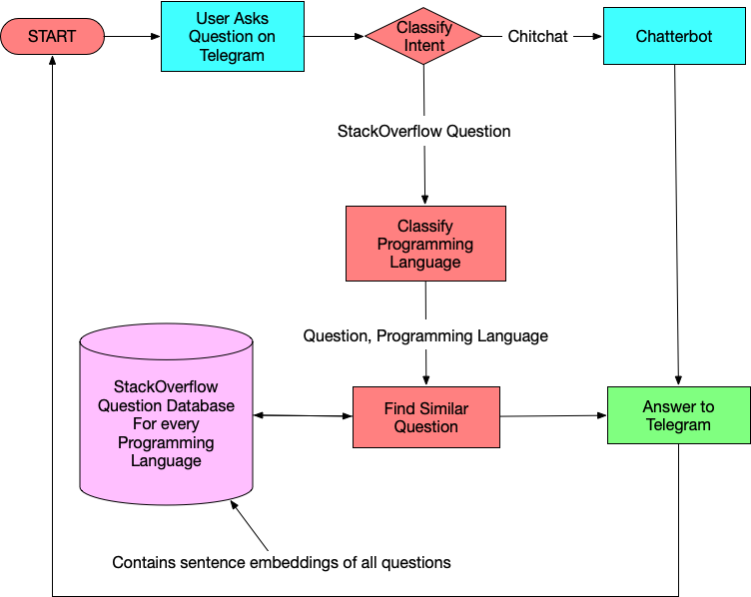
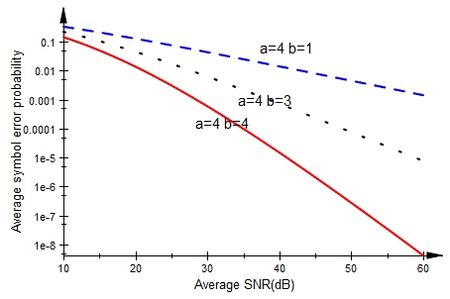
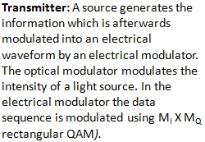
StackOverflow Assistant Chatbout Using NLP
Jasmine Batra | Prof. Sankar Ganesh S | SENSE
Motivation/ Introduction
Results
The main motivation of this project is to build something that is useful for learning (study/work) purposes that save time.
SCOPE of the Project
The main objective of this project is to do a performance analysis in terms of ASEP (Average Symbol Error Probability) versus Average SNR of General-order Quadrature Amplitude Modulation considering atmospheric turbulence effects for the different channel models. The Average symbol error probability for the Log Normal and Gamma Gamma channel models are derived in terms of the Meijer-G function and the effects of decision distance, distance between transmitter and receiver and the turbulence conditions are analyzed. For all the calculations 16 bit QAM (Quadrature Amplitude Modulation) is used. To further improve the signal quality double generalized gamma model is implemented.
Figure 2
Figure 3
Methodology
Figure 4
Figure 5
Figure 2: ASEP of optical communication systems employing general order rectangular QAM versus the average electrical SNR for weak turbulence and decision ratio r=1
Figure 3: ASEP of optical communication systems employing subcarrier general-order rectangular QAM versus the average electrical SNR, for medium turbulence, r = 1, and for various values of L.
Figure 4: ASEP of optical communication systems employing subcarrier general-order rectangular QAM versus the average electrical SNR, for strong turbulence, r = 1, and for various values of L.
Figure 5: ASEP of optical communication systems employing subcarrier general-order rectangular QAM versus the average electrical SNR, for weak turbulence, r = 1, using double generalized gamma distribution.
Figure 6: ASEP of optical communication systems employing subcarrier general-order rectangular QAM versus the average electrical SNR, for strong turbulence strength, r = 1, and for various values of a and b.
Figure 1: Flowchart of our StackOverflow Chatbot
Figure 6
ASEP expression for Log-Normal distribution model
Conclusion/ Summary
The performance of the QAM modulation in FSO systems is analyzed with the ASEP parameter. For different values of the atmospheric turbulence, ASEP is analyzed with respect to the average SNR. For the weak atmospheric turbulence conditions, we used the log normal channel model for implementation of the system. The output observed was that ASEP is increasing with the length of link and decreasing with SNR. For the moderate and strong turbulence observed, as the difference a−b grows smaller, a significant improvement in the error performance is obtained. The final work contains the Double gamma model. Here the work is done for the weak turbulence model. This model showed an ASEP in the range of 10⁻¹² which is indeed showing a better performance than the above two models.
Receiver: In the receiver, the received optical field is focused onto a photo detector, which converts the received optical field to an electrical signal. The electrical signal is demodulated, and the resulting bits are fed into an information sink.
Contact Details
archakpal@yahoo.co.in shubhankarnikhil@gmail.com
Acknowledgments/ References
Kostas P. Peppas and Christos K. Datsikas “Average Symbol Error Probability of General-Order Rectangular Quadrature Amplitude Modulation of Optical Wireless Communication Systems Over Atmospheric Turbulence Channels”, J. OPT. COMMUN. NETW. /VOL. 2, NO. 2/FEBRUARY 2010
Mohammadreza A. Kashani, Student Member, IEEE, Murat Uysal, Senior Member, IEEE, and Mohsen Kavehrad, Fellow, IEEE, “A Novel Statistical Channel Model for Turbulence-Induced Fading in Free-Space Optical Systems”, JOURNAL OF LIGHTWAVE TECHNOLOGY, VOL. 33, NO. 11, JUNE 1, 2015
Hessa AlQuwaiee, Imran Shafique Ansari, and Mohamed-Slim Alouini, “On the Performance of Free-space Optical Wireless Communication Systems over Double Generalized Gamma Fading Channels”, journal of opt.commun.netw.

